Slide 1

The Sodamatic
Notes:
It really do be like that

Slide 2
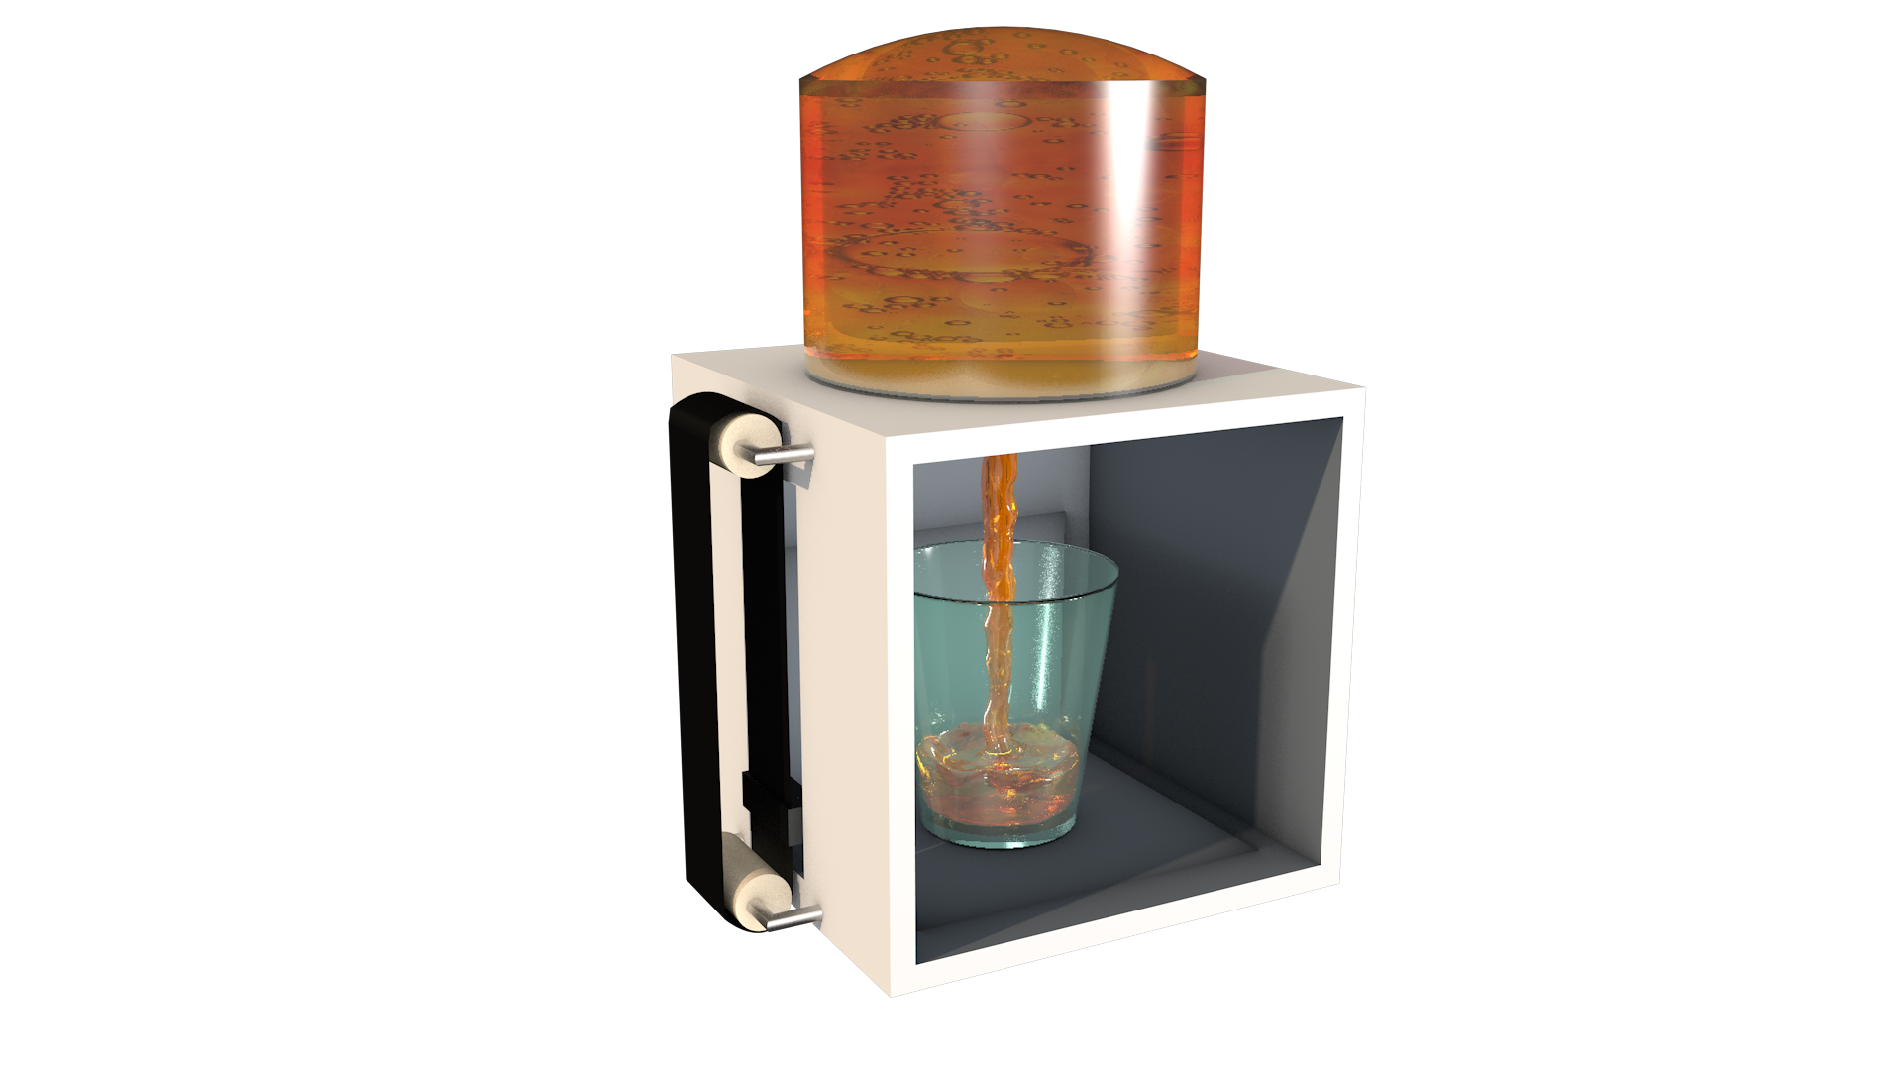
Design
Electrical Components
Arduino Beetle
Raspberry Pi
Infrared Sensors
Wires
Power Adapters
Camera
Mechanical Components
Frame
Valve & Tubing
Servos
Bottle
Hot Glue

Slide 3
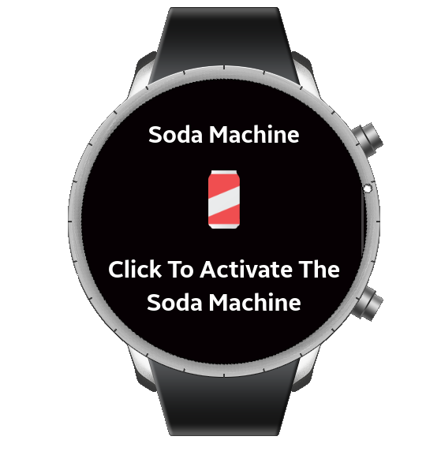
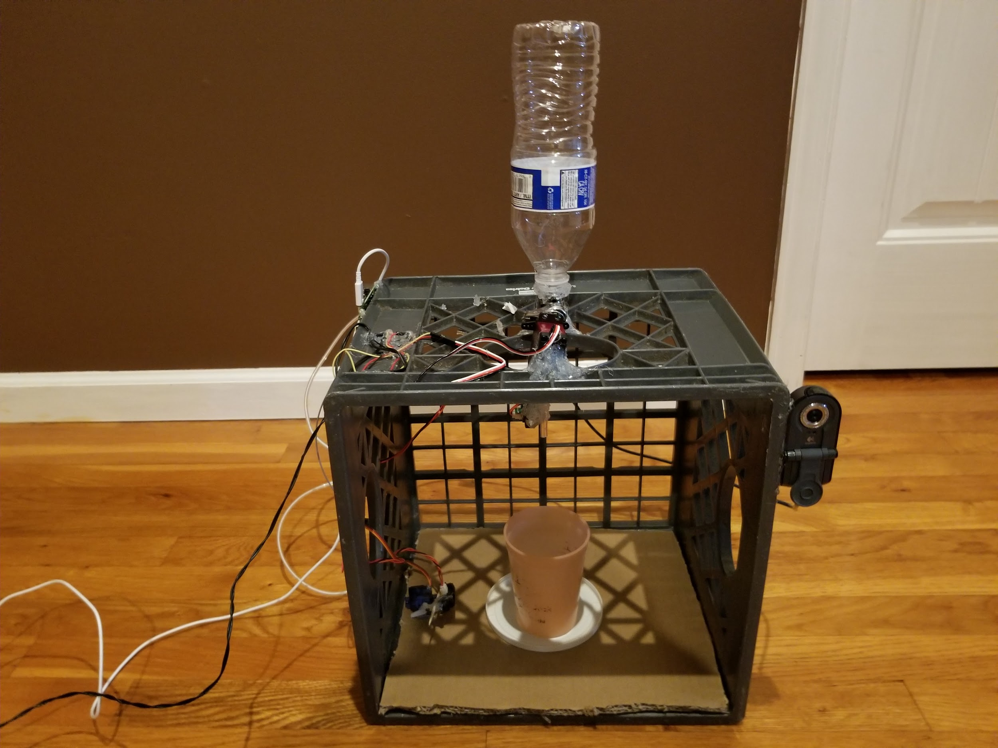
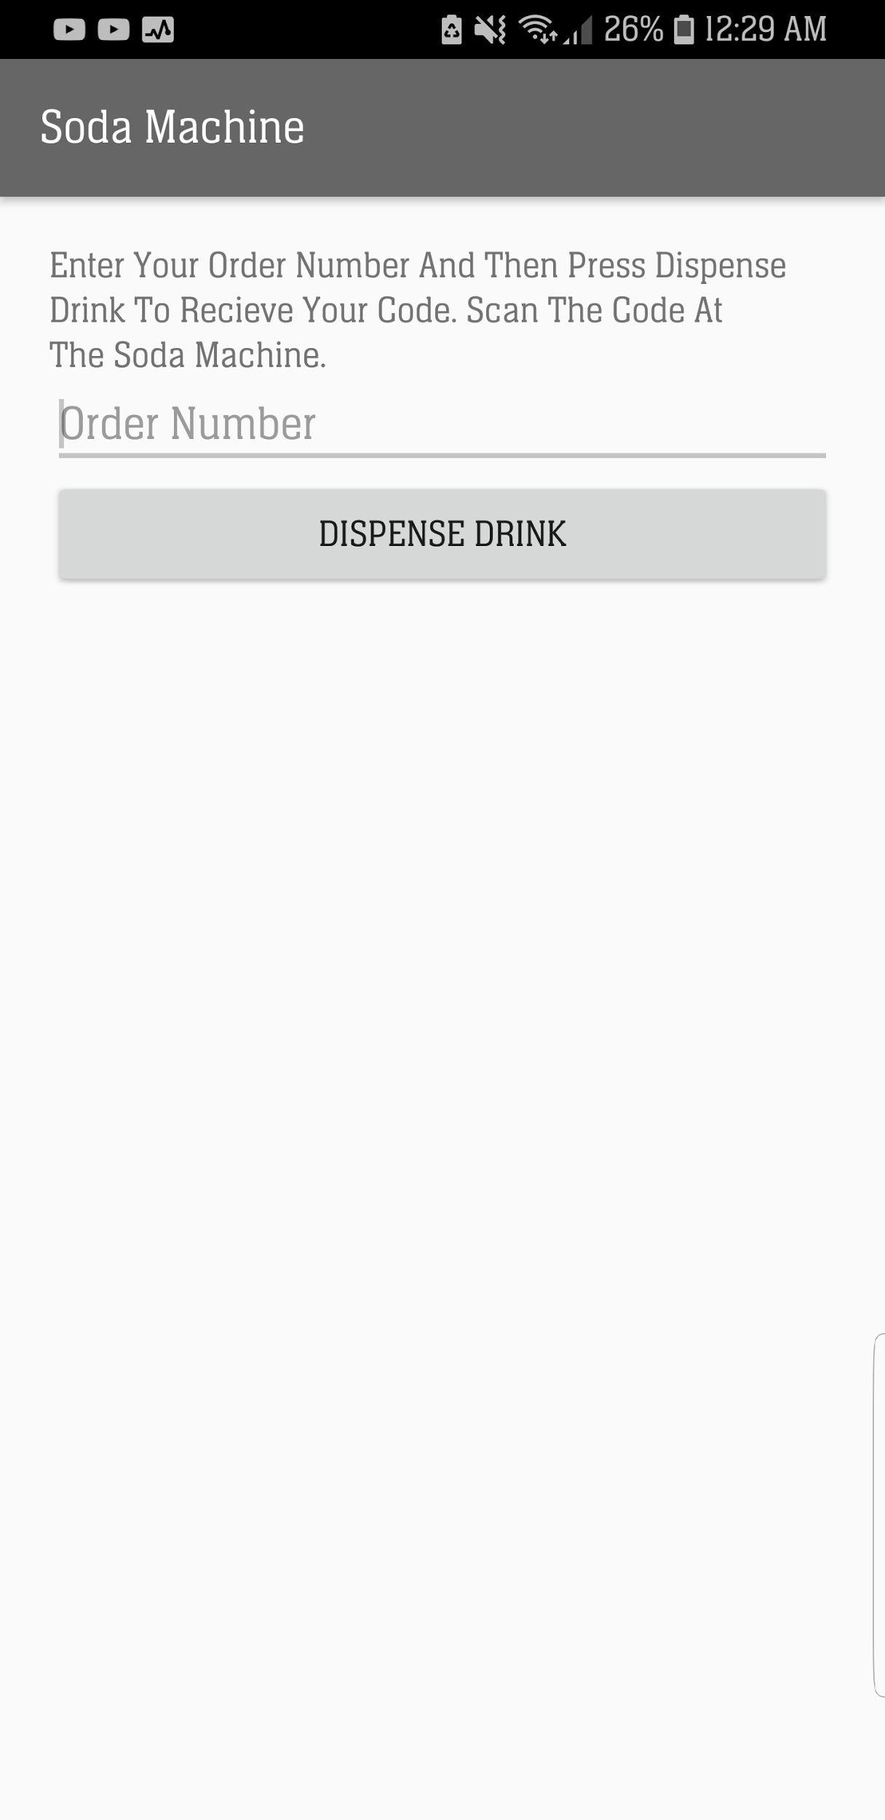

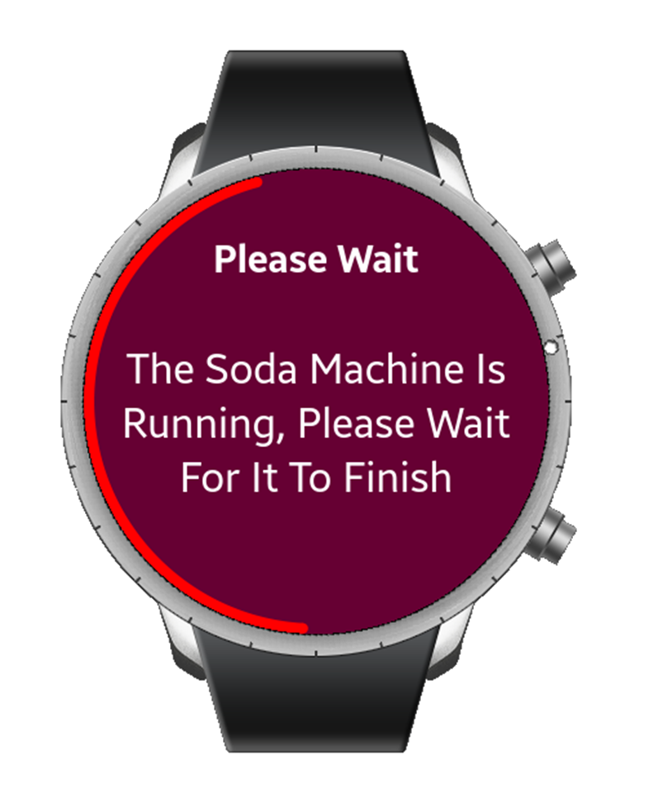
The Machine
Tizen Watch App
Android App
Activation Code

Slide 4
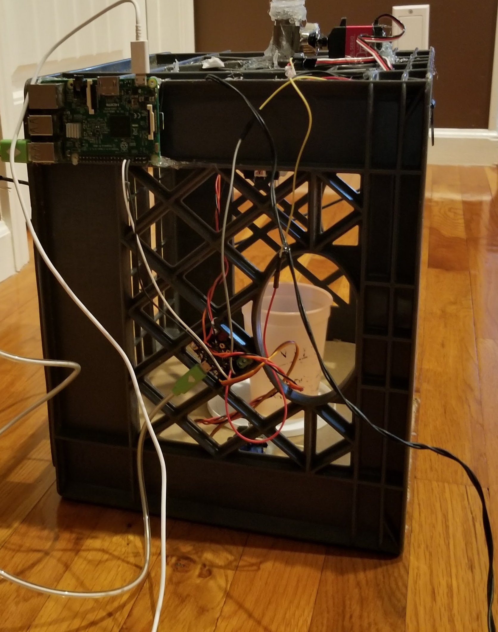
Hardware
Valve
High Torque Servo
Reservoir
Arduino
Infrared Sensors
Small Servo
Camera
Raspberry Pi

Slide 5
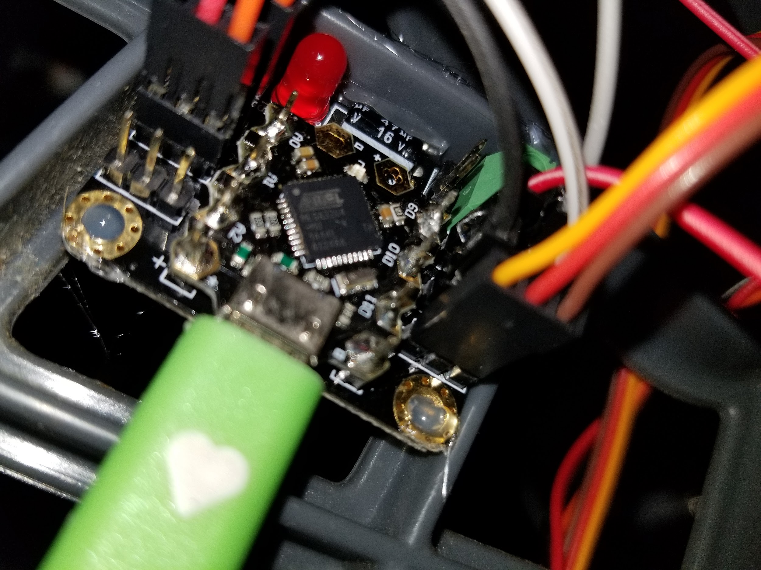
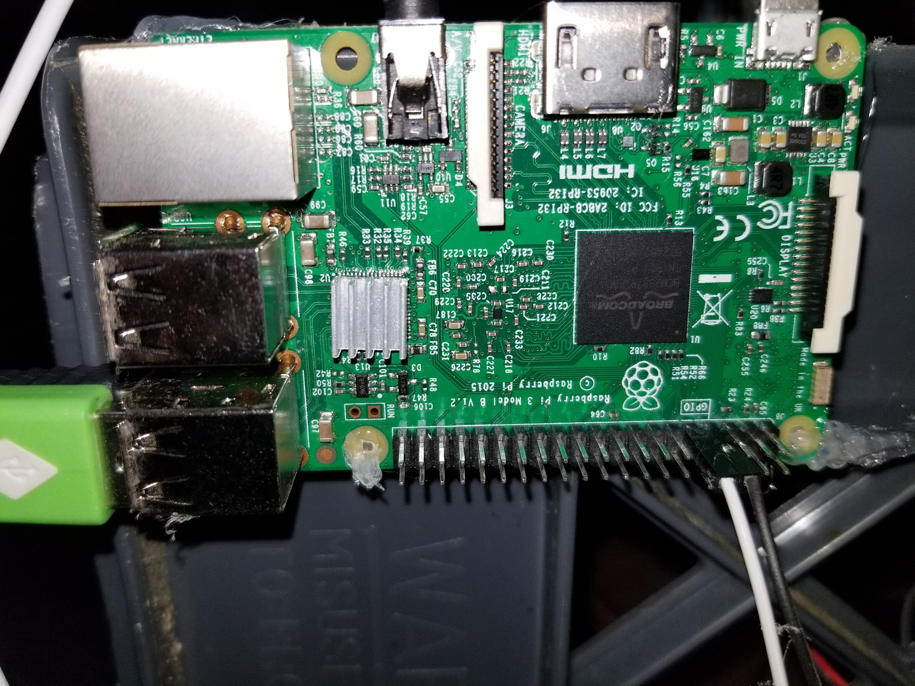
Electrical
Analog Side Pins
Digital Side Pins
Camera USB
Arduino USB
RPI GPIO Link
High Torque Servo
Small Servo
RPI
Infrared Sensors
Arduino Beetle
Arduino GPIO Link

Slide 6
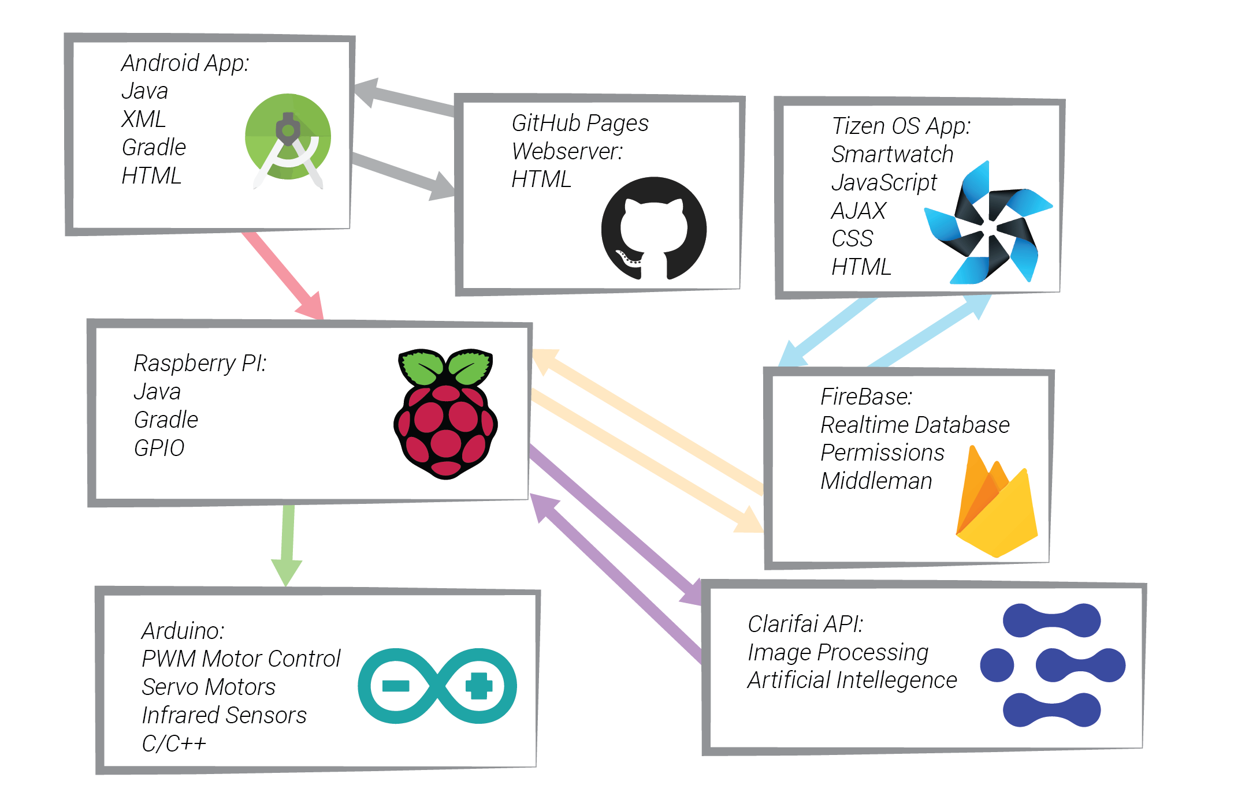
Software Ecosystem

Slide 7
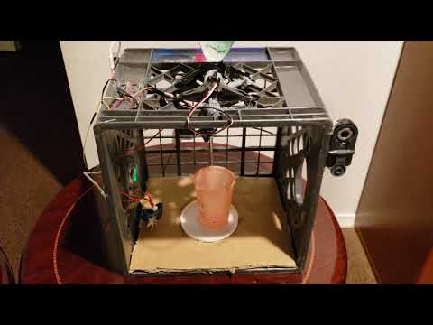
Demonstration

